Slide 1

Finding Appropriate Semantic Web Services based on User Request Term(s)
Pronalaženje Skrivenog Znanja
Student: Profesor:
Miloš Jovanović, 09/3048 dr Veljko Milutinović

Slide 2
1 Introduction

Slide 3
Present situation
Currently, web services interact by passing XML data, with data types specified using XML Schema.
SOAP is used as the communication protocol and the I/O signatures for web services are given by WSDL.
UDDI provides the means to publish and discover web services through a UDDI registry.

Slide 4
What’s the problem?
Increase in number of web services
Lack of semantic base in UDDI search mechanism

Slide 5
Basic terms – UDDI(1)
Universal Description, Discovery and Integration (UDDI) is a platform-independent, XML-based registry for businesses worldwide to list themselves on the Internet.
UDDI enables businesses to publish service listings and discover each other and define how the services or software applications interact over the Internet.

Slide 6
Basic terms – UDDI(2)
A UDDI business registration consists of three components:
White Pages — address, contact, and known identifiers;
Yellow Pages — industrial categorizations based on standard taxonomies;
Green Pages — technical information about services exposed by the business.

Slide 7
Basic terms – UDDI(3)
UDDI is designed to be interrogated by SOAP messages and to provide access to WSDL documents.
UDDI Search Mechanism allows us to search for services by name, by location, by business, by bindings or by Tmodels.

Slide 8
Basic terms – UDDI(4)
Drawbacks:
Limited to keyword matches
Does does not support any inference based on the taxonomies referred to by the Tmodels
Inputs and outputs of web services not taken into account when searching

Slide 9
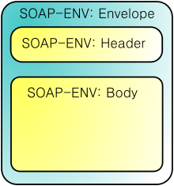
Basic terms – WSDL, SOAP
Web Services Description Language (WSDL) is an XML-based language that provides a model for describing web services.
Simple Object Access Protocol (SOAP) is a protocol specification for exchanging structured information in the implementation of web services.

Slide 10
Basic terms – OWL-S(1)
OWL-S is an ontology built on top of Web Ontology Language (OWL) by the DARPA DAML program and used for describing Semantic Web Services.
OWL-S aims to enable the following tasks:
Automatic web service discovery
Automatic web service invocation
Automatic web service composition and interoperation

Slide 11
Basic terms – OWL-S(2)
OWL-S ontology has three main parts:
Service profile is used to describe what the service does (primary meant for human reading).
Process model describes how a client can interact with the service (inputs, outputs, pre-conditions and results of the service execution).
Service grounding specifies the details that a client needs to interact with the service, as communication protocols, message formats, port numbers, etc.

Slide 12
Solutions
Semantic Enhancement of Input Terms (Smart Web Query Engine)
Matchmaking Algorithm (matching service advertisement and service request)

Slide 13
2 Smart Web Query Engine

Slide 14
Overview
Search engines provide only primitive data query capabilities and require a detailed syntactic specification to retrieve relevant data.
The Smart Web Query method uses domain semantics represented as context ontologies.

Slide 15
How does it work?
User supplies some keyword(s).
System tries to find ontologies that include these terms.
If more ontologies are found, the user is prompted to select the most relevant one.
User keywords are enhanced with synonym and is_a related terms.
All terms are sent to UDDI registry server to retrieve all related web services.

Slide 16
Example (1)
User enters search keyword: “bond”
System: “Bond” can appear in two different ontologies, Financial Investment Ontology and Adhesives Ontology
User selects Financial Investment Ontology.

Slide 17
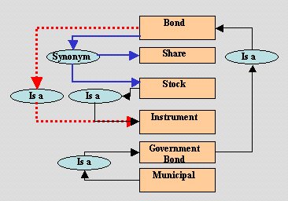
Example (2)
User keywords are enhanced with synonym and is_a related terms.
Terms “bond”, “stock”, “share” and “instrument” are sent to UDDI registry server.

Slide 18
3 Matchmaking Algorithm

Slide 19
Overview
Based on the OWL’s subsumption mechanism.
The matching between the concepts is not syntactic, but it is based on the relation between these concepts in their OWL ontologies.
The matching algorithm recognizes four degrees of match between two concepts.

Slide 20
How does it work? (1)
Matches the outputs of the request against the outputs of the published advertisements.
If any advertisement output is matched, matches the inputs of the request against the inputs of the advertisements.

Slide 21
How does it work? (2)
OutR represents the concept of an output of a request, and OutA that of an advertisement.
The degree of match between OutR and OutA:
exact: OutR and OutA are same or OutR is an immediate subclass of OutA.
plug in: OutA subsumes OutR (OutA can be plugged instead of OutR).
subsume: OutR subsumes OutA.
fail: There is no subsumption relation between OutA and OutR.

Slide 22
Example (1)
Fragment of the vehicle ontology:

Slide 23
Example (2)
Exact: OutR = “Sedan”, OutA = “Car”
Plug in: OutR = “Sedan”, OutA = “Vehicle”
Subsume: OutR = “Car”, OutA = “Sedan”
Fail: OutR = “Truck”, OutA = “Car”

Slide 24
4 System Architecture

Slide 25
Overview
The Smart Web Query Engine and the Matchmaking Algorithm are joined together in a system called Semantic Search Agent.
The Semantic Search Agent communicates with users, the UDDI Registry, various Sematnic Web Services and the (local) Ontologies Database.

Slide 26
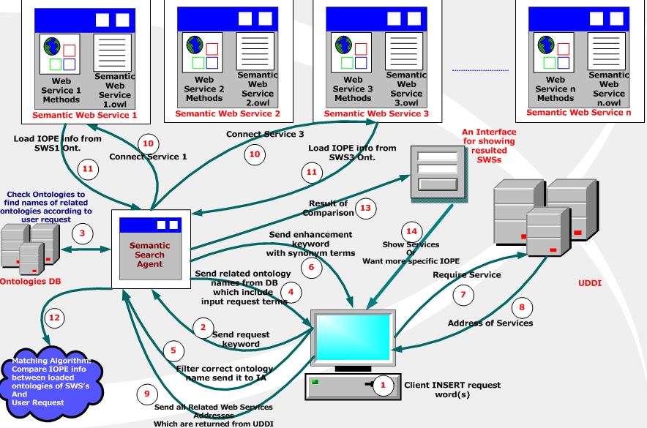
SSA Process Chart

Slide 27
SSA Process Explanation (1)
User enters some keyword(s).
Keywords are sent to SSA.
The SSA checks the ontologies DB and finds all ontologies related to those keywords.
If more ontologies are found, SSA prompts the user to pick the one he wanted to search for.

Slide 28
SSA Process Explanation (2)
User responds by selecting one ontology.
User keywords are enhanced with synonym and is_a related terms and sent to client.
Client forwards enhanced keywords to UDDI Registry search mechanism.
UDDI Registry returns addresses of services found (to client).

Slide 29
SSA Process Explanation (3)
Client sends search results (addresses of services) to SSA.
SSA contacts all services (using addresses received from client) and requires their IOPE (Input, Output, Precondition and Effect) information.
Each SWS submits requested IOPE info to SSA.

Slide 30
SSA Process Explanation (4)
The Matchmaking Algorithm compares IOPE information gathered from SWS with user request.
Results of comparison are used to form an interface for showing information about suggested services to the user.
User can accept theese results or ask for more specific services (by supplying more specific IOPE).

Slide 31
Conclusion (1)
Only two properties are being used by SSA for semantic enhancement of user input terms.
Different properties may be employed depending on requirements of the interest domain.
Increasing the number of properties can improve system performance.

Slide 32
Conclusion (2)
This approach may be applied in numerous search domains (especially in the period of transition to the Semantic Web).

Slide 33
References
http://en.wikipedia.org
D. Celik, A. Elgi: “A semantic search agent approach: finding appropriate semantic Web services based on user request term(s)”, 2005 Enabling Technologies for the New Knowledge Society: ITI 3rd International Conference Page(s):675 - 687
Roger H.L. Chiang, Cecil Eng Huang Chua and Veda C. Storey: “A smart web query method for semantic retrieval of web data”, Data & Knowledge Engineering, Volume 38, Issue 1,Pages63-84
N. Srinivasan, M. Paolucci, and K. Sycara: “Adding OWL-S to UDDI, implementation and throughput”, First International Workshop on Semantic Web Services and Web Process Composition (SWSWPC), San Diego, California, USA

Slide 34
THE END
Thank you for you attention!

